Slide 1
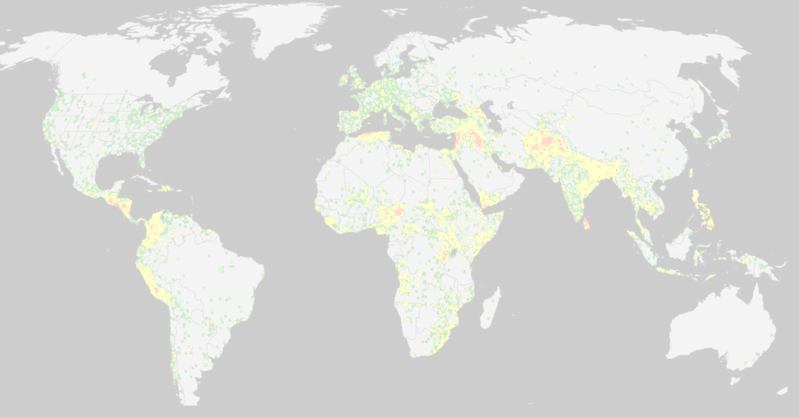

Max Herrera, Joshua Herrera, Patrick McDevitt, and Sunna Quazi
MSDS 7330 File Organization and Database Management
Section 405, Group A

Slide 2

Global Terrorism Database
Open-source database including information on terrorist events around the world
Terrorist Attacks from 1970-2015
156,772 terrorist attacks
More than 83,000 bombings, 18,000 assassinations, and 11,000 kidnappings since 1970
137 Attributes
Systematic data on domestic as well as international terrorist incidents
Over 4,000,000 news articles and 25,000 news sources were reviewed to collect incident data from 1998 to 2016 alone
https://www.kaggle.com/START-UMD/gtd. (29 Mb)
https://www.start.umd.edu/gtd
Currently the most comprehensive unclassified database on terrorist events in the world

Slide 3

GTD defines Terrorism as:
"The threatened or actual use of illegal force and violence by a non-state actor to attain a political, economic, religious, or social goal through fear, coercion, or intimidation."

Slide 4
Team Project
Identified GTD as opportunity to explore / organize / normalize / evaluate a large dataset in support of objectives of this course
Identified relational database as most supportive for this database and project
Convert raw data set to usable tables
Imported to SQL database
Normalized database
Identified time-based and geographic insights

Slide 5


Why Choose SQL?
We didn’t know about MongoDB until last week ;)
Raw dataset was in tabular / column structure
The 137 attributes are interdependent, which complement an relationship database
There was seemingly a great amount of redundant data, which would benefit from normalization
Relational database facilitates analyzing the multiple subtypes of information: geographic, forensic, demographic, political
Dataset is ~big, but not huge

Slide 6

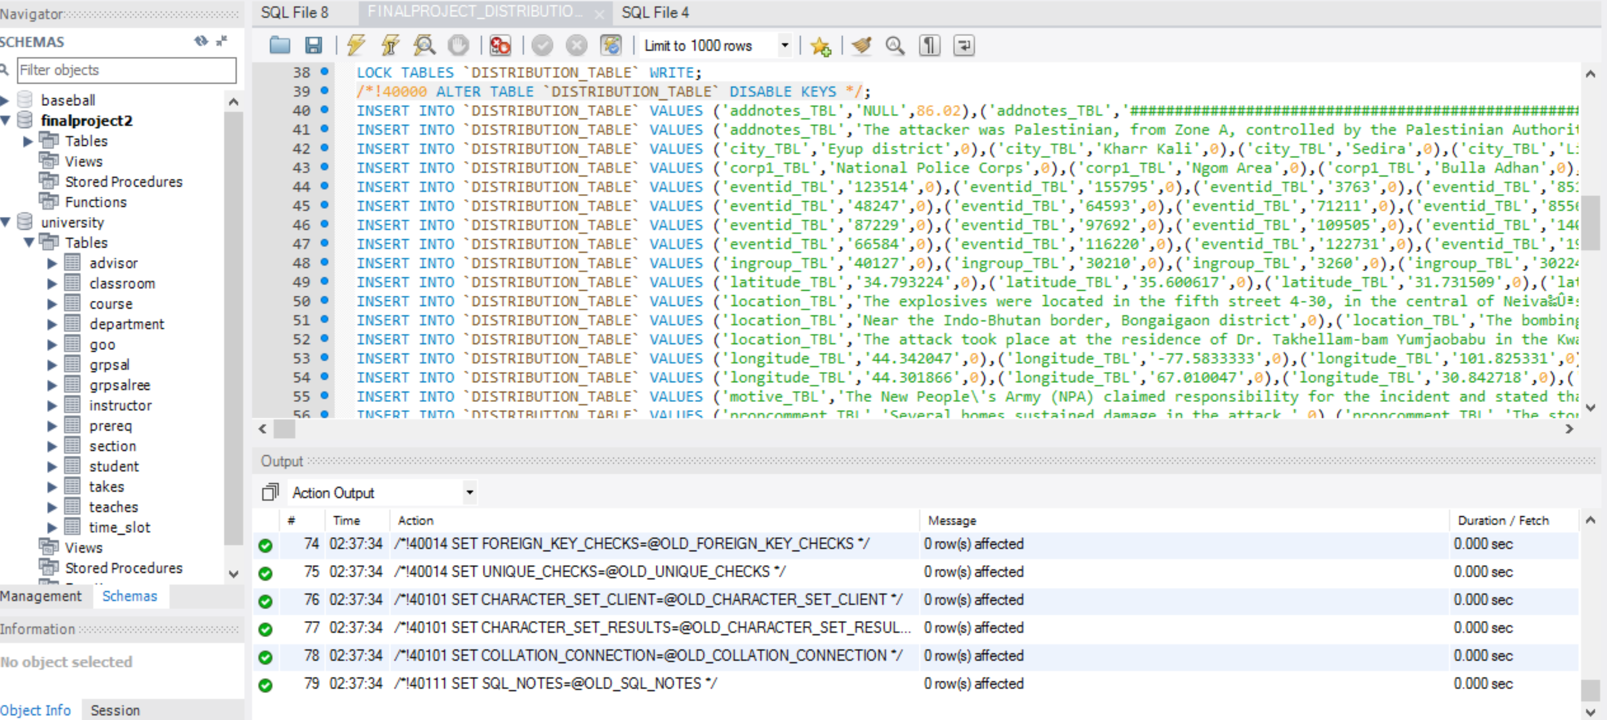

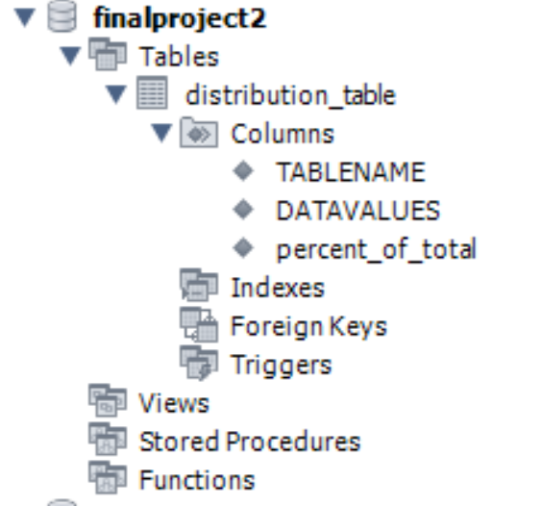
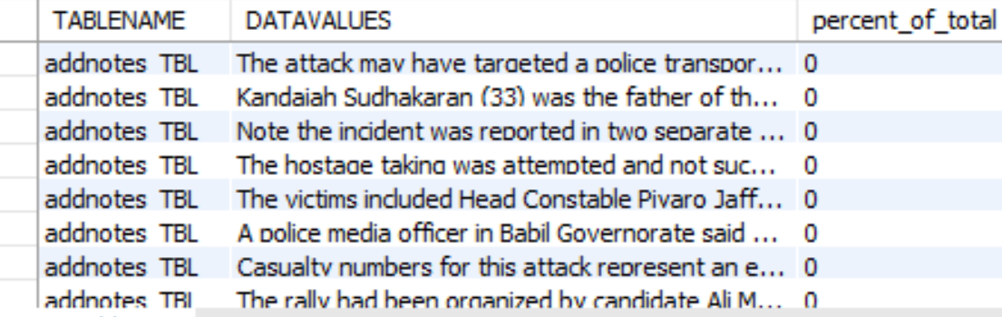
Data Loading Pitfalls
Initially, the GT data would not import into MYSQL
We needed to make each column varchar(MAX) initially.
Each column was surrounded by triple quotes, so we cleaned up the data.
File size of DDL file 48.8mb
Data Definition File (DDL)
Loaded Schema
Table Excerpt

Slide 7

Data Wrangling
Import the data into a Microsoft SQL Server database.
We needed to make each column varchar(MAX) initially. Each column was surrounded by triple quotes, so we cleaned up the data:
Write scripts to determine the max length of each column, and alter the column width for each of the 127 columns accordingly.
Use the sliding window functions to determine distribution of values for each of the 127 columns.
Output the distribution of values per column into one table, DISTRIBUTION_TABLE.
Connect the SQL server to MYSQL to transfer the data using SSIS via an ODBC connection.
Perform a MYSQL dump of the data for the GT (I.e., the global terrorism table) and the DISTRIBUTION_TABLE and uploaded it into box so that it could be loaded by the other teammates.
This allowed the team to start with the same dataset.
All the scripts that were created to wrangle, and analyze the data can be found here. https://smu.box.com/s/zhbm2idikopnuhxfvcxtmc880nud5pxa. There were 22 scripts written to wrangle and profile the data. The SQL dump generated to scripts, which can be found in the importdataintomysql folder. The stored procedures and sql used is for both microsoft sql server and mysql

Slide 8

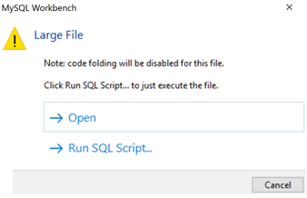
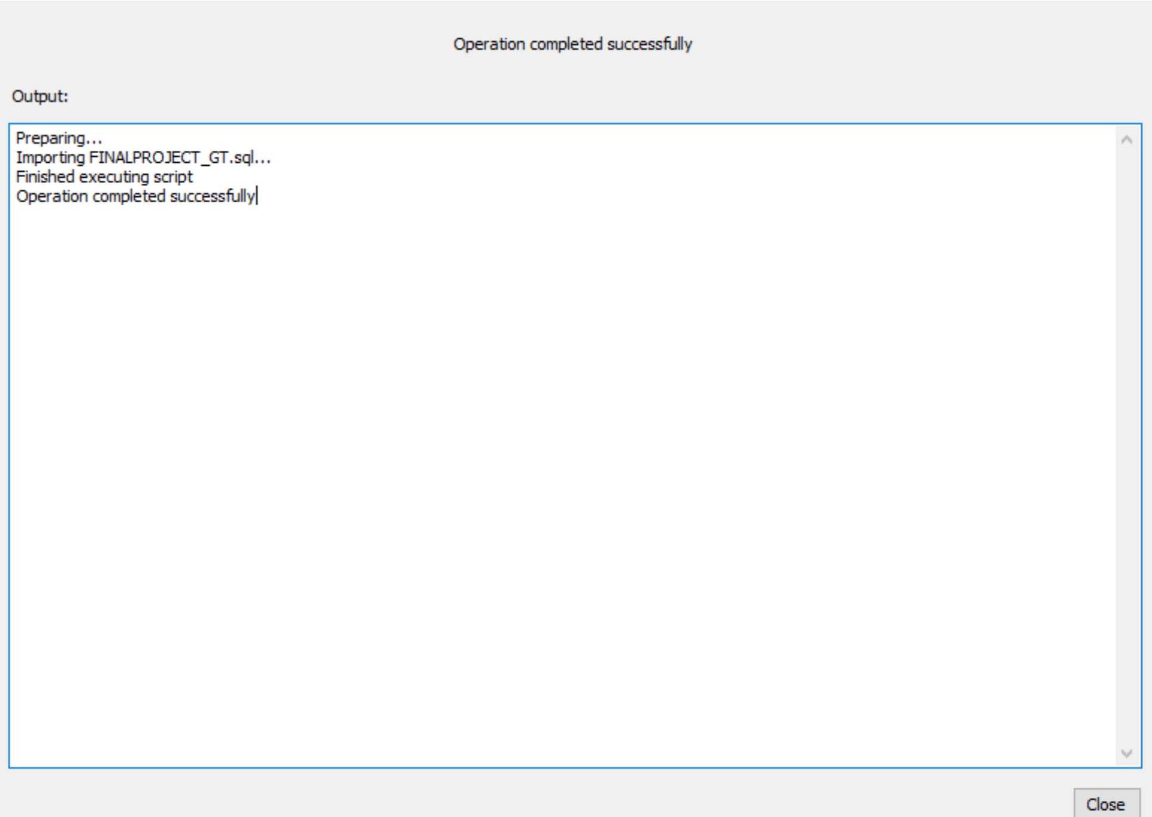
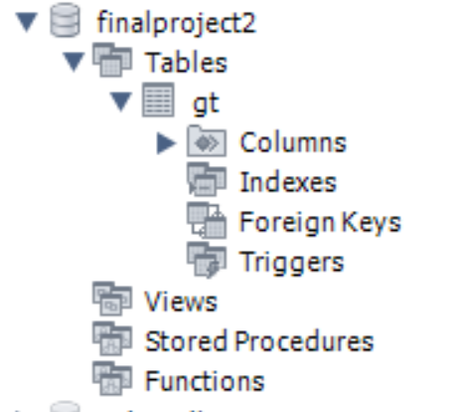
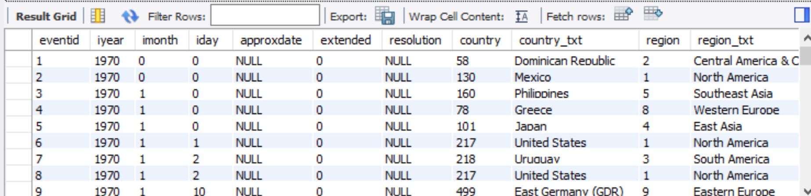

Our Framework
do we need to explain why we grew database 10X and is that a good thing ???
Final File size is 201mb (from 29mb)
Loading Data- Too Large
Importing
Loaded Schema
Table Excerpt
Summary

Slide 9

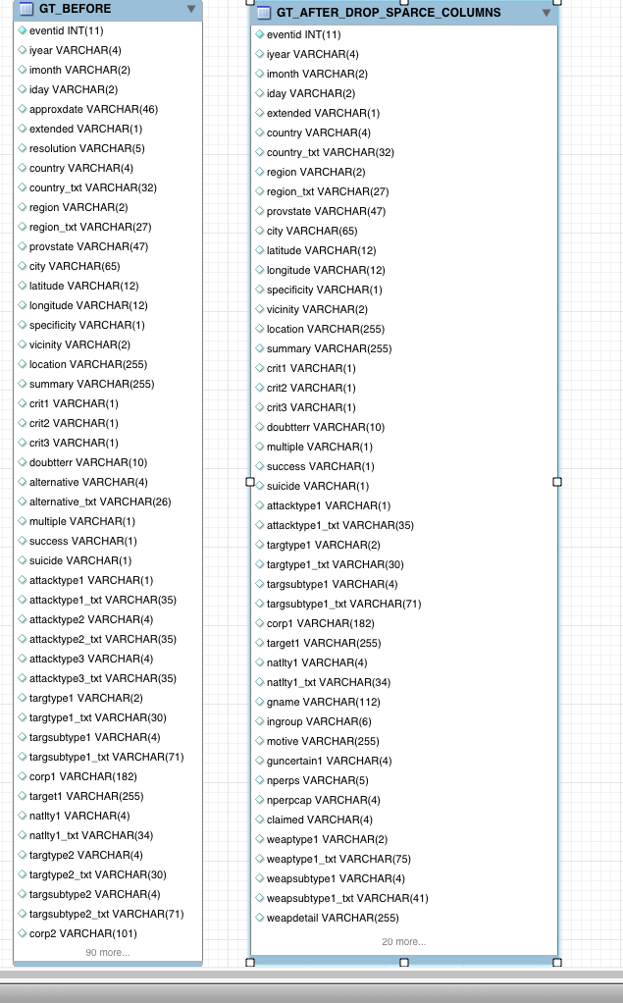
Data Profiling
Having moved the data to MYSQL, we ran scripts that determined which columns were sparse
The criterion for sparseness was that 80% or more of the column was NULL or contained ‘.’
“When you look into an abyss, the abyss also looks into you “
-Frederick Nietzsche
We created alter tables for the sparse columns and dropped them
At this point, the table was ready for normalization

Slide 10
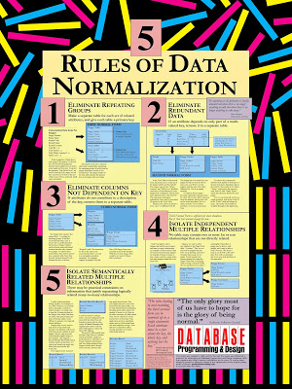
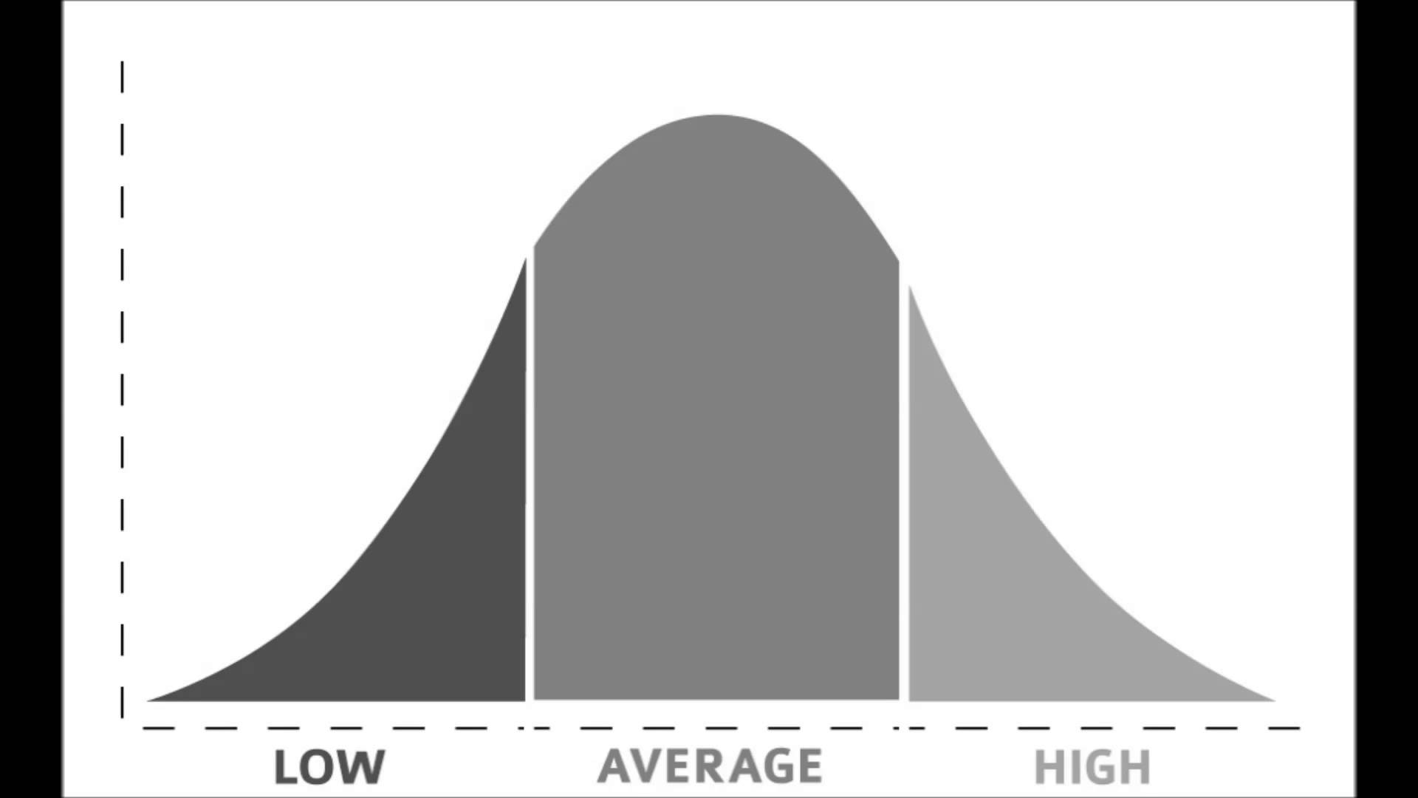
Data Normalization
The data was profiled using SQL Server Data Profiler
The profiler suggested that nine tables could be extracted from the large GT table.
Individual tables were created using the columns from GT. These nine individual tables were validated by joining back to GT.
The redundant columns were dropped form GT because they had been moved to the individual tables.
Primary keys were created on the nine tables.
From there, indices were created on the join columns in the GT table. Finally, a nine-way inner join was performed with the GT table to validate that everything has worked correctly.

Slide 11
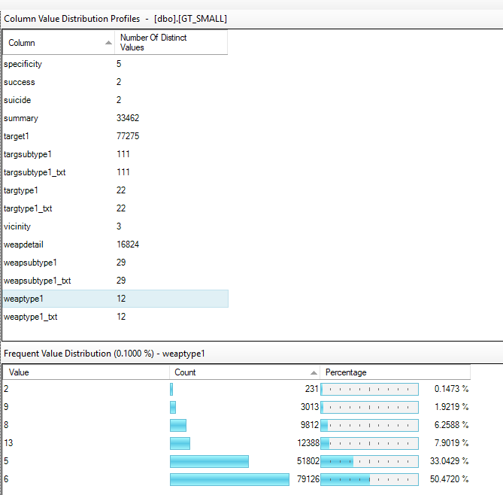
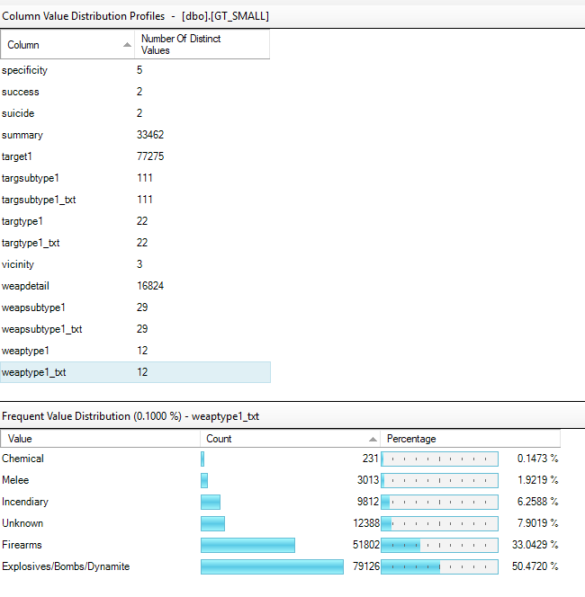
Before Normalization
After Normalization
We should say something about how these graphs imply normalization
&
maybe why it makes sense (relationally)

Slide 12
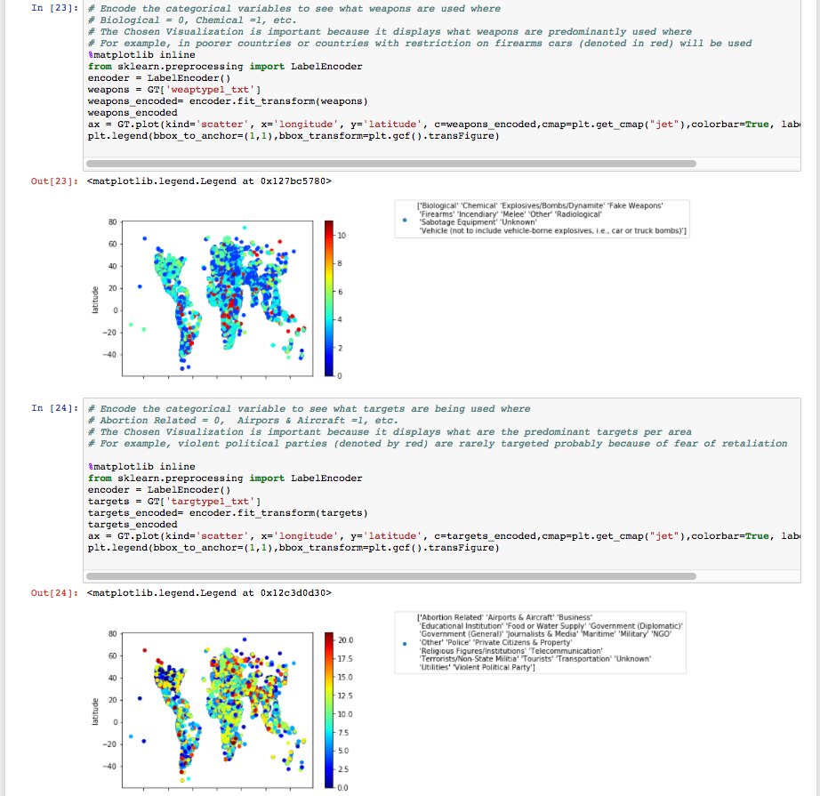

Data Analysis: Python
combine slide 12, 13, 14 into 1 slide
do we actually need the code, or can we just show the images and results ??
We used python to analyze the data, and found that weapon of choice in indigent countries is the motor vehicle.
Deduction: The favorite target of terrorists are abortion related centers and airports.

Slide 15
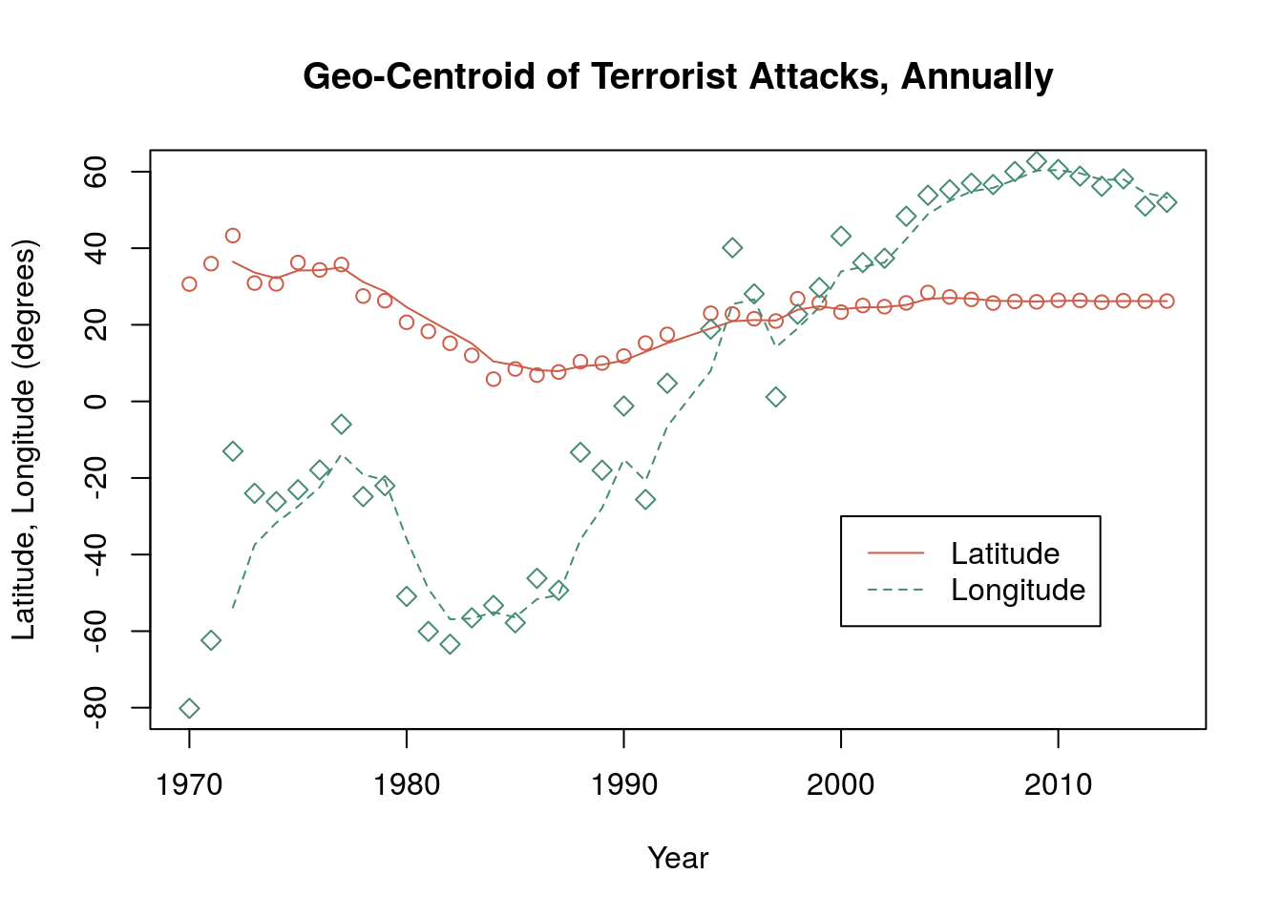

Data Analysis: R
combine slide 15 & 16 into 1 slide
add a take-away box at bottom with significance
To understand Event Clustering and Geographic Trends:
Each geographic center of attacks for each year is depicted in longitude and latitude
In 1970: the center was in the North Atlantic Ocean (just off the east coast of the US)
We can also observe that since 1970, attacks are moving eastward

Slide 16

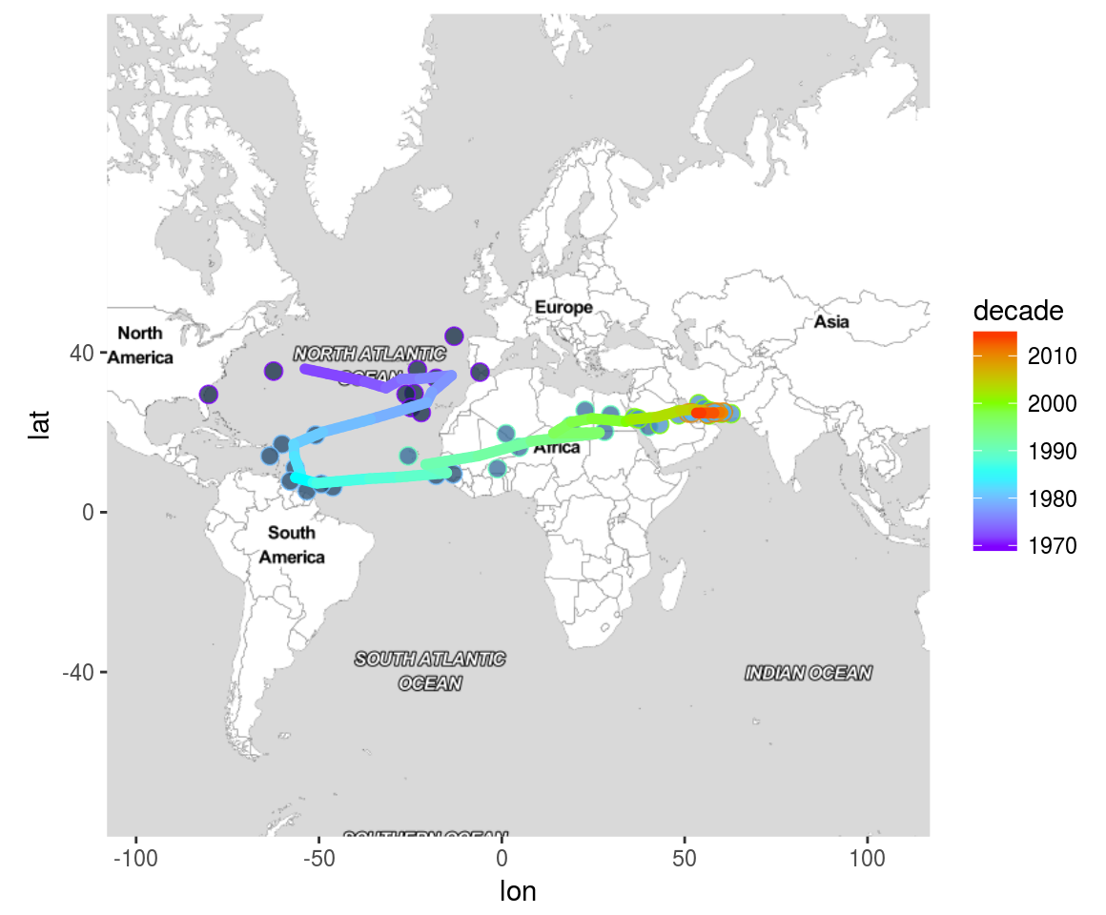
R Analysis: Geographic Clustering on Map Over Time

Slide 17

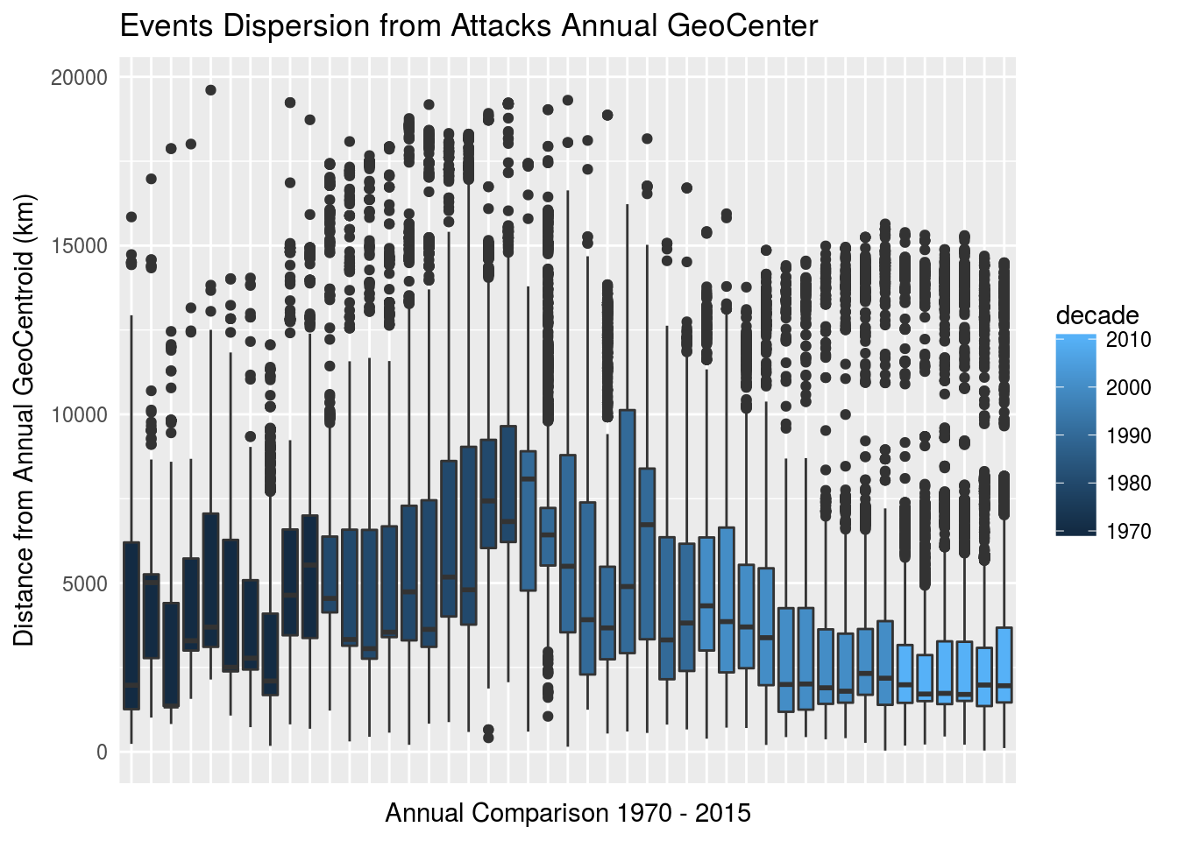
Geographic Center and Dispersion
1970s - large majority of events occurred within a 5000 km distance from the geocentroid
1980s - the average distance increases slightly (now located between western Europe or northern South America) and a clear bi-modal trend begins to emerge. There is a population of events that appear consistently at more than 15000 km from the annual center.
1990s - slight reduction in population distance from the annual mean, and also a return to a primarily uni-model distribution, as the overall centroid begins to march eastward across Africa
2000s - much stronger concentration of events to the annual center - now generally within 4000 km of the annual center and a reappearance of a bi-modal distribution of events
2010s - least dispersion in the overall population difference from the annual centers. Thus, in the current era, there is a very strong concentration of terrorist events in the Mid-East, but also two other locations affected by 25% of the events.
reduce number of words in text box
add a take-away box at bottom with significance
we also need to add a timeline plot somewhere that shows increasing trend of number of events each year …. maybe this chart is good place to do that ??

Slide 18
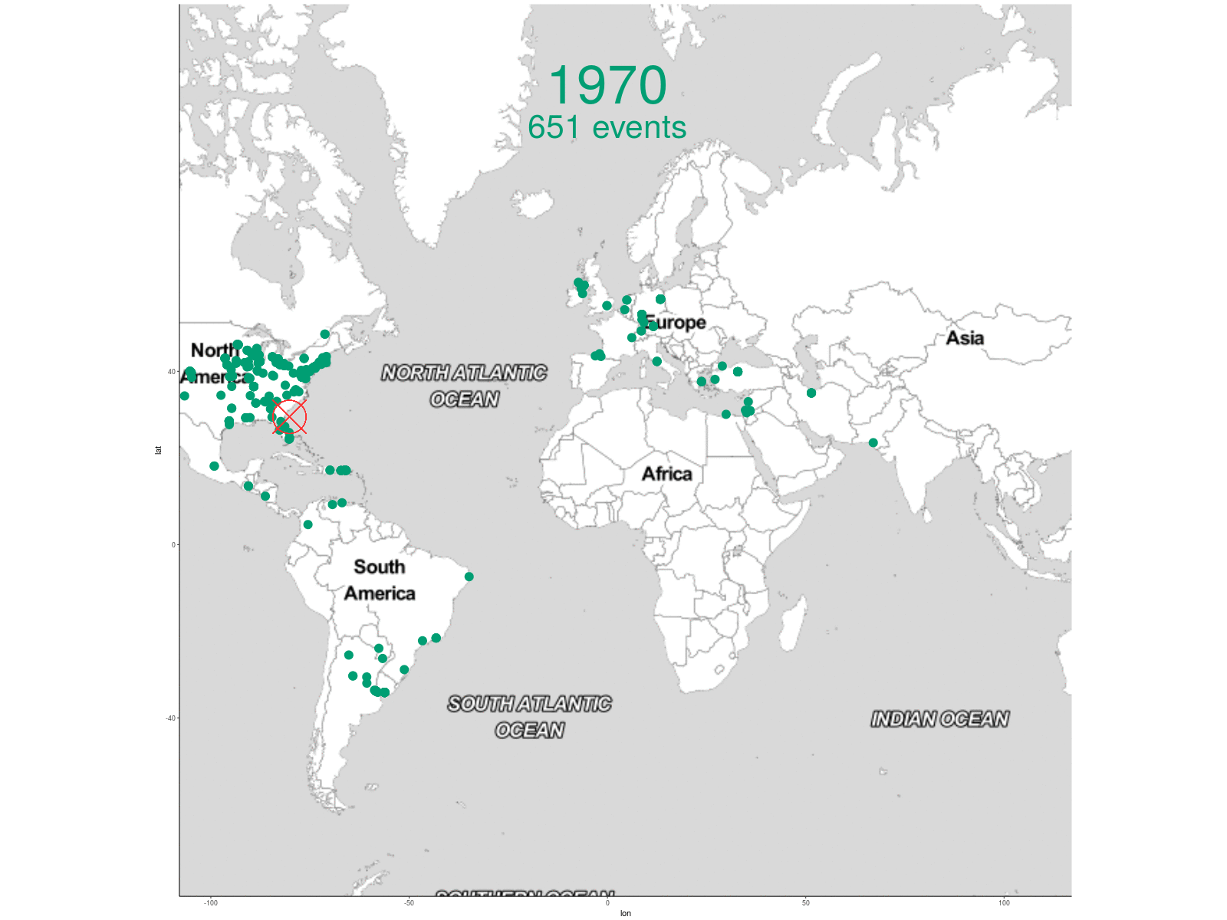
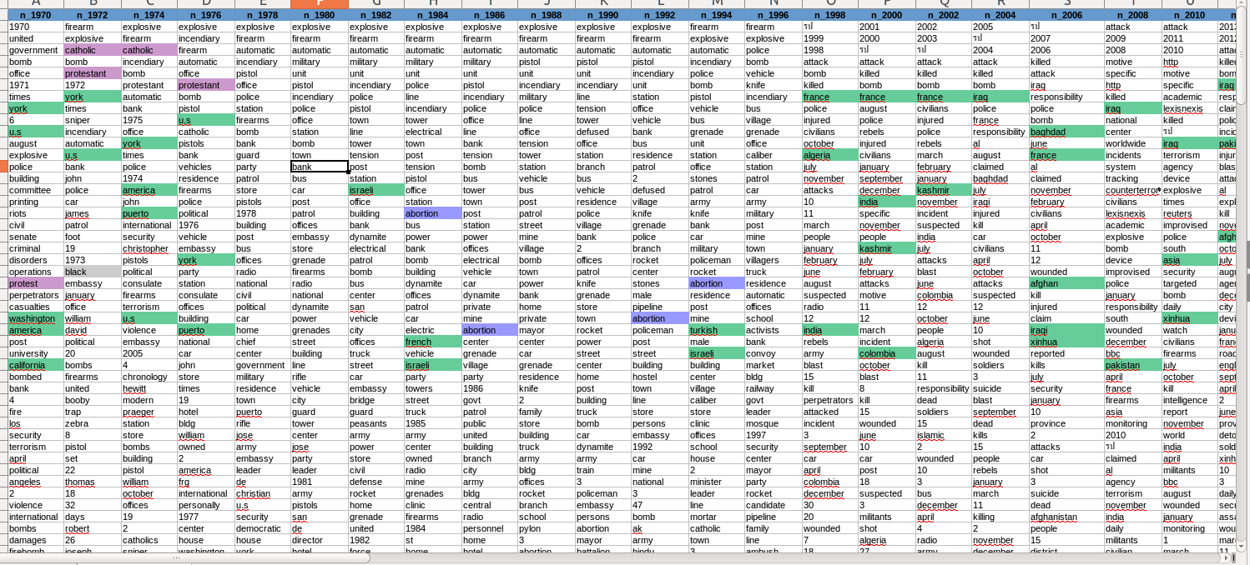
this is animated gif that cycles thru the years in presentation mode
Observable Trends
1970s: Catholics vs. Protestants, US, Puerto Rico
1980s: Abortion, Israel
1990s: Turkey, Israel, India
I think I have a word analysis by decade that may be easier to read … I'll look for that
add a take-away box at bottom with significance

Slide 19

Conclusions
we should list the specific insights from terrorist data base that we are claiming as interesting …
small countries choice of weapons, event count changing over time, text analysis as indicator changing trends, geographic changes over the decades, …..
I think JW said we should have 5 insights … let's be clear about exactly they are from us
Data is growing exponentially
SQL can be used to understand a new and seemingly overwhelmingly large datasets without destroying preexisting relationships
Our Python analysis allowed us to key trends that can allow us to predict and possibly deter future attacks
Motor Vehicles are the primary means of conducting terror
Abortion Centers and Airports are primary targets of terror
Nothing is constant. Our R analysis provides us insight into the evolution of modern terrorism so we can be better prepared for future developments

